Slide 1
MySQL Cluster
[NEC Group Internal Use Only]
OSS Technical Center
NEC Telecom Software Philippines

Slide 3
Table of Contents
NDB Cluster Replication Overview
General Requirements for NDB Cluster Replication
Requirements
Things to consider
Known Issues
Configuration
Parameters
Configuration Procedure
Confirming Replication Status

Slide 4
MySQL Cluster Investigation

Slide 5
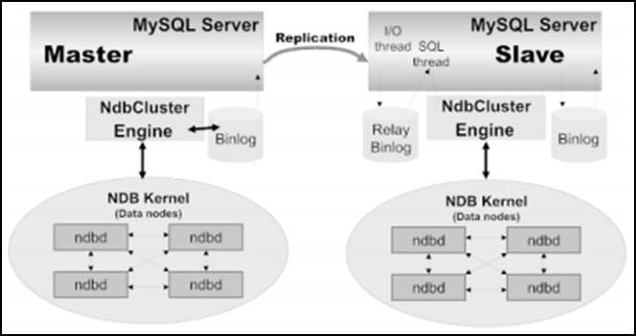
NDB Cluster Replication Overview
NDB Cluster Replication
NDB Cluster supports asynchronous replication, more usually referred to simply as "replication".
NDB Cluster depends on the NDB storage engine for clustering functionality, it is not necessary to use NDB as the storage engine for the slave's copies.
For maximum availability, it is possible to replicate from one NDB Cluster to another.
In the image above, successive states of the master cluster are logged and saved to a slave cluster using the NDB binary log injector thread. The NDB binary log injector thread runs on each MySQL server and produces a binary log (binlog). The thread ensures that all changes in the cluster producing the binary log and not just those changes that are affected through the MySQL Server are inserted into the binary log with the correct serialization order. MySQL Replication master and replication slaves servers as replication servers or replication nodes and the data flow or line of communication between them as a replication channel.

Slide 6
General Requirements for NDB Cluster Replication
A replication channel requires two MySQL Servers acting as replication servers.
MySQL Server must be running with –binlog-format=[ROW | MIXED]; Can also be configured as parameter in my.cnf file.
NOTE: Default value for –binlog-format is MIXED in NDB 7.5. In NDB Cluster Replication, always use row-based replication. The NDB storage engine is incompatible with statement-based replication.
Each MySQL server used for replication in either cluster must be uniquely identified among all the MySQL replication servers participating in either cluster. This can be done by starting mysqld in each node using the –server-id=<ID> option where ID is a unique integer.; Can also be configured as parameter in my.cnf file.
NOTE: You cannot have replication servers on both the master and slave clusters sharing the same ID.
MySQL Replication that both MySQL servers (mysqld processes) involved must be compatible with one another with respect to both the version of the replication protocol used and the SQL features sets which they support.
All NDB tables being replicated must be created using a MySQL server and client.

Slide 7
MySQL Cluster Replication Threads
MySQL Replication capabilities are implemented using three threads, one on the master and two on the slave:
Binlog Dump Thread
The master creates a thread to send the binary log contents to a slave when the slave connects. This thread can be identified in the output of SHOW PROCESSLIST on the master as the Binlog Dump Thread.
The binary log dump thread acquires a lock on the master’s binary log for reading each event that is to be sent to the slave. As soon as the event has been read, the lock is released, even before the event is sent to the slave.
Slave I/O Thread
When a START SLAVE statement is issued on a slave server, the slave creates an I/O thread, which connects to the master and asks it to send the updates recorded in its binary logs.
Slave SQL Thread
The slave creates an SQL thread to read the relay log that is written by the slave I/O thread and execute the events contained therein.

Slide 8
NDB Cluster Replication Things to Consider
If you attempt to use NDB Cluster Replication with --binglog-format=STATEMENT, replication fails to work properly because the ndb_binlog_index table on the master and the epoch column of the ndb_apply_status table on the slave are not updated. Instead, only updates on the MySQL server acting as the replication master propagate to the slave and no updates from any other SQL nodes on the master cluster are replicated.
Use the same NDB Cluster distribution for all master and slave mysqld binaries.
Tables and other database objects created using the NDB API are not visible to a MySQL server and so are not replicated. Updates by NDB API applications to existing tables that were created using a MySQL server can be replicated.
Log file names are based on the server host name if you do not specify a file name with the startup option. To retain the same log file names if you change your host name to something else, you must explicitly use options such as --log-bin=old_host_name-bin.

Slide 9
NDB Cluster Replication Known Issues
Loss of master-slave connection.
A loss of connection can occur either between the replication master SQL node and the replication slave SQL node, or between the replication master SQL node and the data nodes in the master cluster. In the latter case, this can occur not only as a result of loss of physical connection (for example, a broken network cable), but due to the overflow of data node event buffers; if the SQL node is too slow to respond, it may be dropped by the cluster
Circular replication
The SQL nodes on all masters and slaves are the same.
All SQL nodes acting as replication masters and slaves are started using the --log-slave-updates option.
NDB Cluster Circular Replication Where Not All Masters Are Slaves should be possible, but it should be noted that it has not yet been thoroughly tested and must therefore still be considered experimental.

Slide 10
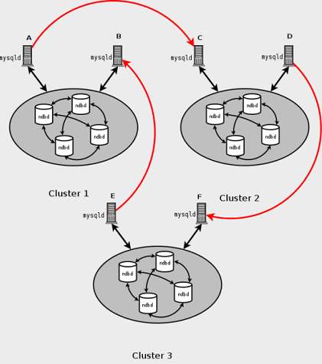
NDB Cluster Replication Known Issues
The image shows an example of a replication
setup involving three NDB Cluster s numbered 1, 2, and 3, in which Cluster 1 acts as the replication
master for Cluster 2, Cluster 2 acts as the master for Cluster 3, and Cluster 3 acts as the master for
Cluster 1. Each cluster has two SQL nodes, with SQL nodes A and B belonging to Cluster 1, SQL
nodes C and D belonging to Cluster 2, and SQL nodes E and F belonging to Cluster 3.

Slide 11
NDB Cluster Replication Known Issues
Restarting with --initial.
Restarting the cluster with the --initial option causes the sequence of GCI and epoch numbers to start over from 0. (This is generally true of NDB Cluster and not limited to replication scenarios involving Cluster.) The MySQL servers involved in replication should in this case be restarted. After this, you should use the RESET MASTER and RESET SLAVE statements to clear the invalid ndb_binlog_index and ndb_apply_statustables, respectively.
Multiple masters not supported when replicating NDB to other storage engines.
In MySQL 5.7.3 and later, if you specify --log-bin option without also specifying a --server-id, the server is not allowed to start. (Bug #11763963, Bug #56739)

Slide 12
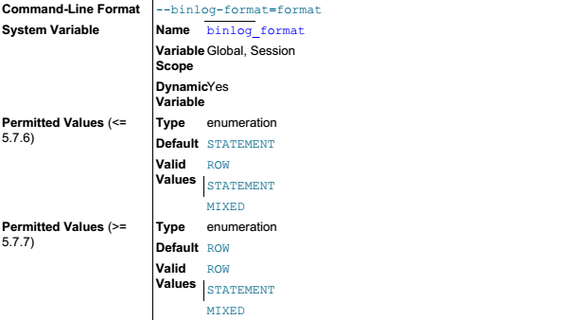
Configuration Parameters
--binlog-format={ROW|STATEMENT|MIXED}
Specify whether to use row-based, statement-based, or mixed replication. Statement-based is the default in MySQL 5.7.
Under some conditions, changing this variable at runtime is not possible, or causes replication to fail.
NOTE: While you can change the logging format at runtime, it is not recommended that you change it while replication is ongoing. This is due in part to the fact that slaves do not honor the master's binlog_format setting; a given MySQL Server can change only its own logging format.
Setting the binary logging format without enabling binary logging sets the binlog_format global system variable and logs a warning.

Slide 13
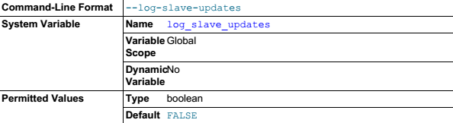
Configuration Parameters
--log-slave-updates
Normally, a slave does not write any updates that are received from a master server to its own binary log. This option causes the slave to write the updates performed by its SQL thread to its own binary log. For this option to have any effect, the slave must also be started with the --log-bin option to enable binary logging. --log-slave-updates is used when you want to chain replication servers. For example, you might want to set up replication servers using this arrangement: A -> B -> C
Here, A serves as the master for the slave B, and B serves as the master for the slave C. For this to work, B must be both a master and a slave. You must start both A and B with --log-bin to enable binary logging, and B with the --log-slave-updates option so that updates received from A are logged by B to its binary log.

Slide 14
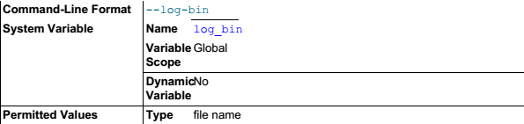
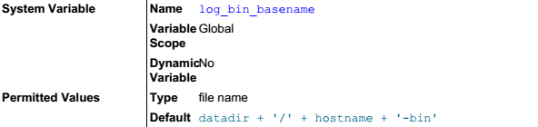
Configuration Parameters
--log-bin[=base_name]
Enable binary logging. The server logs all statements that change data to the binary log, which is used for backup and replication. The option value, if given, is the base name for the log sequence. The server creates binary log files in sequence by adding a numeric suffix to the base name. It is recommended that you specify a base name. Otherwise, MySQL uses host_name-bin as the base name. Setting this option causes the log_bin system variable to be set to ON(or 1), and not to the base name. The binary log file name (with path) is available as the log_bin_basename system variable
log_bin_basename
Holds the name and complete path to the binary log file. Unlike the log_bin system variable, log_bin_basename reflects the name set with the --log-bin server option.

Slide 15
Configuration Procedure
Replication Preparation
Check all MySQL Servers for version compatibility
Create a slave account on the master cluster with the appropriate privileges:
NOTE: For security reasons, it is preferable to use a unique user account—not employed for any other purpose—for the replication slave account.
Configure the slave to use the master. Using the MySQL Monitor, this can be accomplished with the CHANGE MASTER TO statement:
Ensure that each MySQL server acting as a replication master is configured with a unique server ID, and with binary logging enabled, using the row format.
NOTE: These options can be set either in the master server's my.cnf file, or on the command line when starting the master mysqld process.
mysqlM> GRANT REPLICATION SLAVE ON *.* TO 'slave_user'@'slave_host' IDENTIFIED BY 'slave_password';
slave_user is the slave account user name
slave_host is the host name or IP address of the replication slave
slave_password is the password to assign to this account
mysqlS> CHANGE MASTER TO MASTER_HOST='master_host', MASTER_PORT=master_port, MASTER_USER='slave_user', MASTER_PASSWORD='slave_password';
master_host is the host name or IP address of the replication master
master_port is the port for the slave to use for connecting to the master
slave_user is the user name set up for the slave on the master
slave_password is the password set for that user account in the previous step

Slide 16
Configuration Procedure
Starting the NDB Cluster Replication (Single Replication Channel)
Start the MySQL replication master server by issuing this command:
Start the MySQL replication slave server as shown here:
It is necessary to synchronize the slave server with the master server's replication binary log. If binary logging has not previously been running on the master, run the following statement on the slave:
Finally, you must instruct the slave to begin applying replication by issuing this command from the mysqlclient on the replication slave:
shellM> mysqld --ndbcluster --server-id=id --log-bin &
id is this server's unique ID
shellM> mysqld --ndbcluster --server-id=id &
id is this server's unique ID
mysqlS> CHANGE MASTER TO MASTER_LOG_FILE=‘logfile', MASTER_LOG_POS=4;
logfile is the binary log of the master server
Note: This instructs the slave to begin reading the master's binary log from the log's starting point.
mysqlS> START SLAVE;
Note: This also initiates the transmission of replication data from the master to the slave

Slide 17
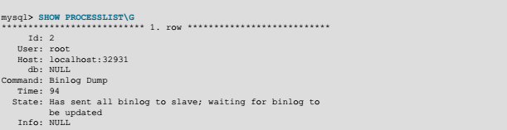
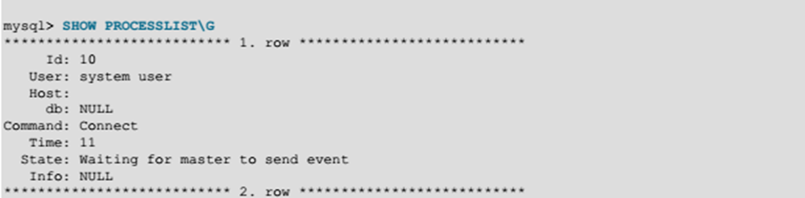
Confirming Replication Status
In the master server, the output of SHOW PROCESSLIST command in sql client should be:
The thread in the master server has an ID of 2. Thread 2 is a Binlog Dump replication thread as specified in the Command field with Binglog Dump value. The State information indicates that all outstanding updates have been sent to the slave and that the master is waiting for more updates to occur.
If there is no Binlog Dump threads on a master server, it means that replication is not running; that is, no slaves are currently connected.
In the slave server, the output of SHOW PROCESSLIST command in sql client should be:

Slide 18
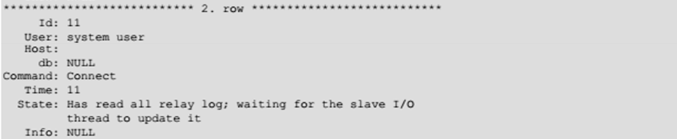
Confirming Replication Status
The State information indicates that thread 10 is the I/O thread that is communicating with the master server, and thread 11 is the SQL thread that is processing the updates stored in the relay logs. At the time that SHOW PROCESSLIST was executed, both threads were idle waiting for further updates.

